Slide 1



INTERACTIVE WEBPAGE
Name : Mohamed Assif Sulthan .M Roll no : 212402802
NMID : 64F2CF8BEE9B36587A44E3BD8F7C0EB3
Dept : BCA
College : SRM Arts and Science College

Slide 2



DIGITAL
Portfolio

Slide 3



AGENDA
PROBLEM STATEMENT PROJECT OVERVIEW END USER
TOOLS & TECHNOLOGIES DESIGN & LAYOUT FEATURES & FUNCTIONALLY
RESULTS AND SCREENSHOTS CONCLUSION
GITHUB LINK

Slide 4

PROBLEM STATEMENT
Freshers find it difficult to showcase skills and projects
Companies prefer one online link instead of
multiple files
Need for a personal portfolio website as a digital resume

Slide 5


PROJECT OVERVIEW
It is a simple resume format done with useful tools like HTML,CSS and JavaScript
It is useful to download resume in a ppt format

Slide 6

END USER
Teachers to monitor our progress HR to oversee our performance

Slide 7

TOOLS & TECHNOLOGIES
HTML5 – Structure CSS3 – Styling & Layout
JavaScript – Functionality Media/Graphics – Icons, profile photo

Slide 8

DESIGN & LAYOUT
Header with profile photo + name Navigation bar for easy sections
Sections: About, Education, Projects, Resume, Contact Responsive design with clean layout

Slide 9

FEATURES & FUNCTIONALITY
Works on both desktop & mobile Resume download button
Contact section with email, phone & socials Projects showcase (Portfolio Website + ToDo App)

Slide 10

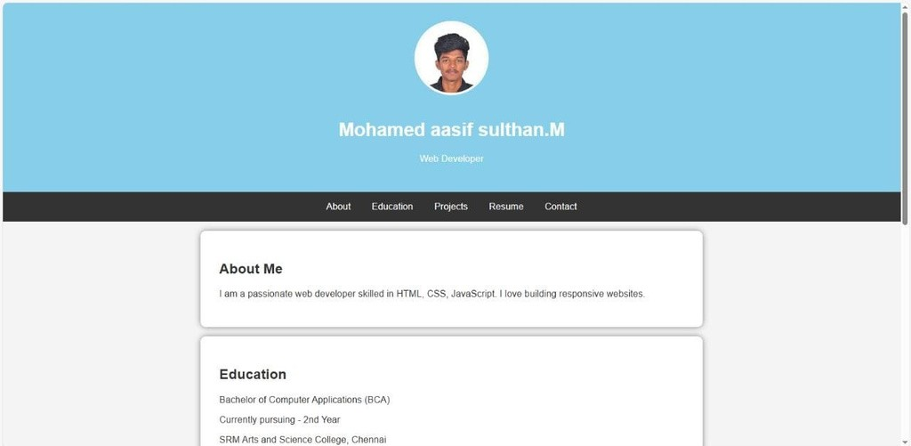
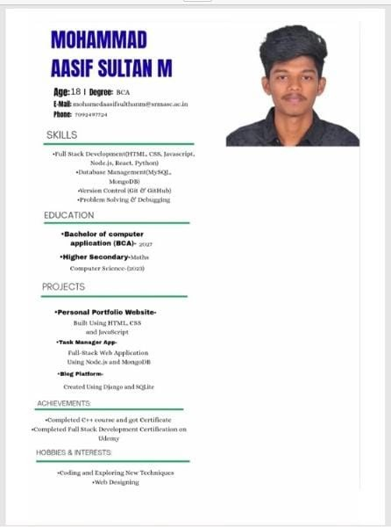
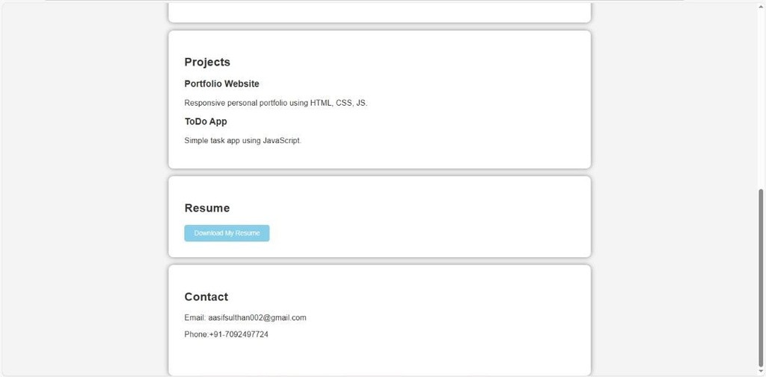
RESULTS AND SCREENSHOTS

Slide 11


CONCLUSION
Portfolio Website serves as a digital resume Easy to showcase projects & skills
Goal: Become a professional web developer

Slide 12
GITHUB LINK
https://aasifm-bca.github.io/nm/

